Slide 1
Nakuja Internship
Edwin Mwiti
Week 2 progress report

Slide 2
Tasks last week
[#1 Research on data transmission]
[#43 Test and receive over LoRa]
[#44 Test send image over LoRa]
[#48 Test max distance of LoRa]
[#45 Test speed and bandwidth of LoRa]

Slide 3
Findings
Data transmission
I configured the ESP32 flight modules to access Wi-Fi and send data
I wired the LoRa Module on ESP32 to test for the speed and data transmission bandwidth

Slide 4
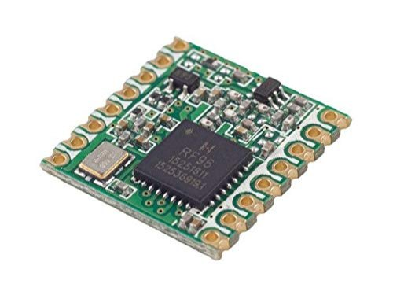
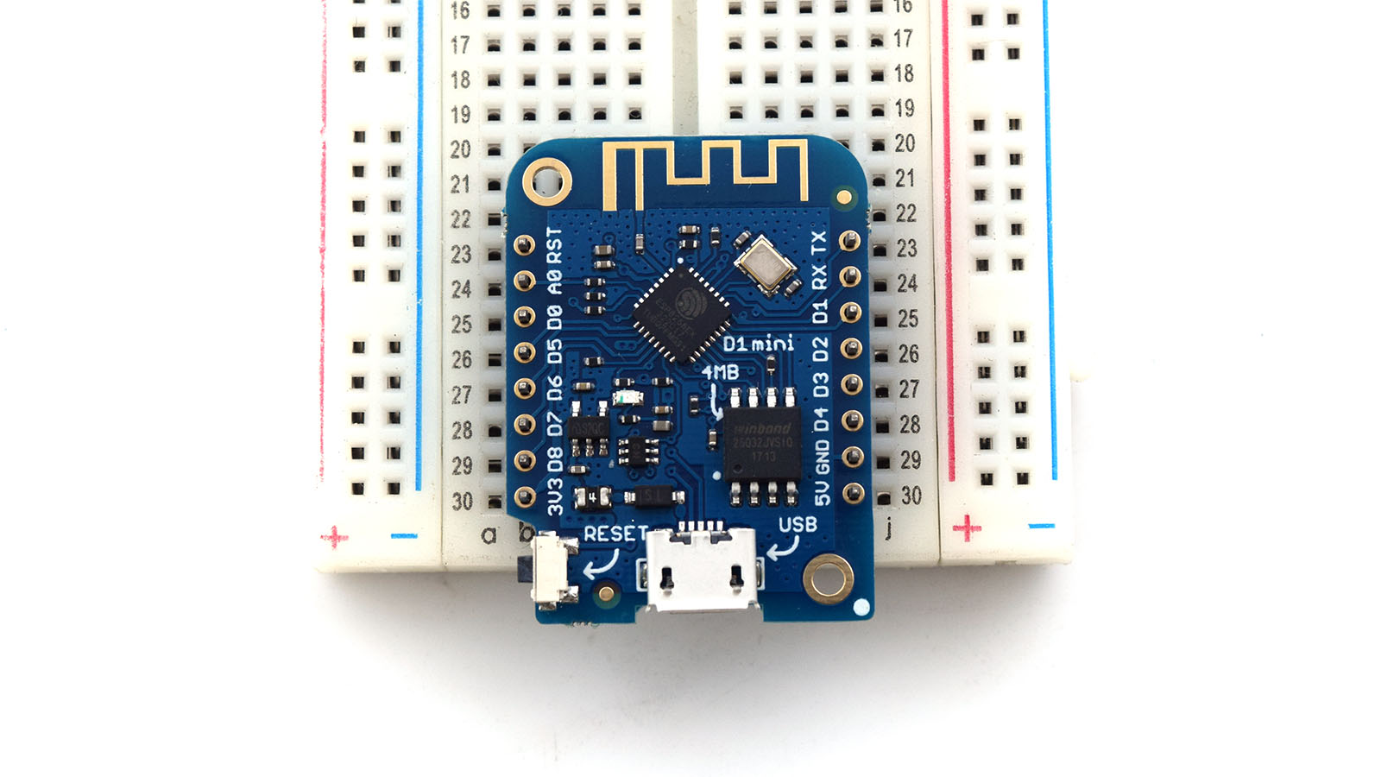
#43 Test and receive over LORA
Hardware used
1. RF96 LoRa Module
2. LOLIN(Wemos) ESP8266 board

Slide 5
Factors affecting lora range
Spreading factor
Supported value- 6 – 12. I choose 12 as the max SF.
Max power attainable at SF 12 is +17dB
Choosing a larger value increases the traversing time making data transmission slower
Transmitting power
This value was not experimented because higher transmission power increase the range
Bandwidth
A low signal bandwidth gives more range theoretically. The transceivers did not communicate at a low bandwidth ~7.8kHz so we choose a larger value ~125kHz

Slide 6
Antenna parameters
I used a generic antenna with a signal gain of 2.0dBi and a RSSI(Received signal Strength Indicator) value of ±4dB

Slide 7
Ranges obtained
I tested the range to be within the apogee limit of N2 which is 500m
The data recovery was found to be fairly bad in line with our requirements though I did not receive any faulty packets. The message was able to be transmitted as is.
Speed of transmission was very low which rules out the need to use LoRa For transmission

Slide 8
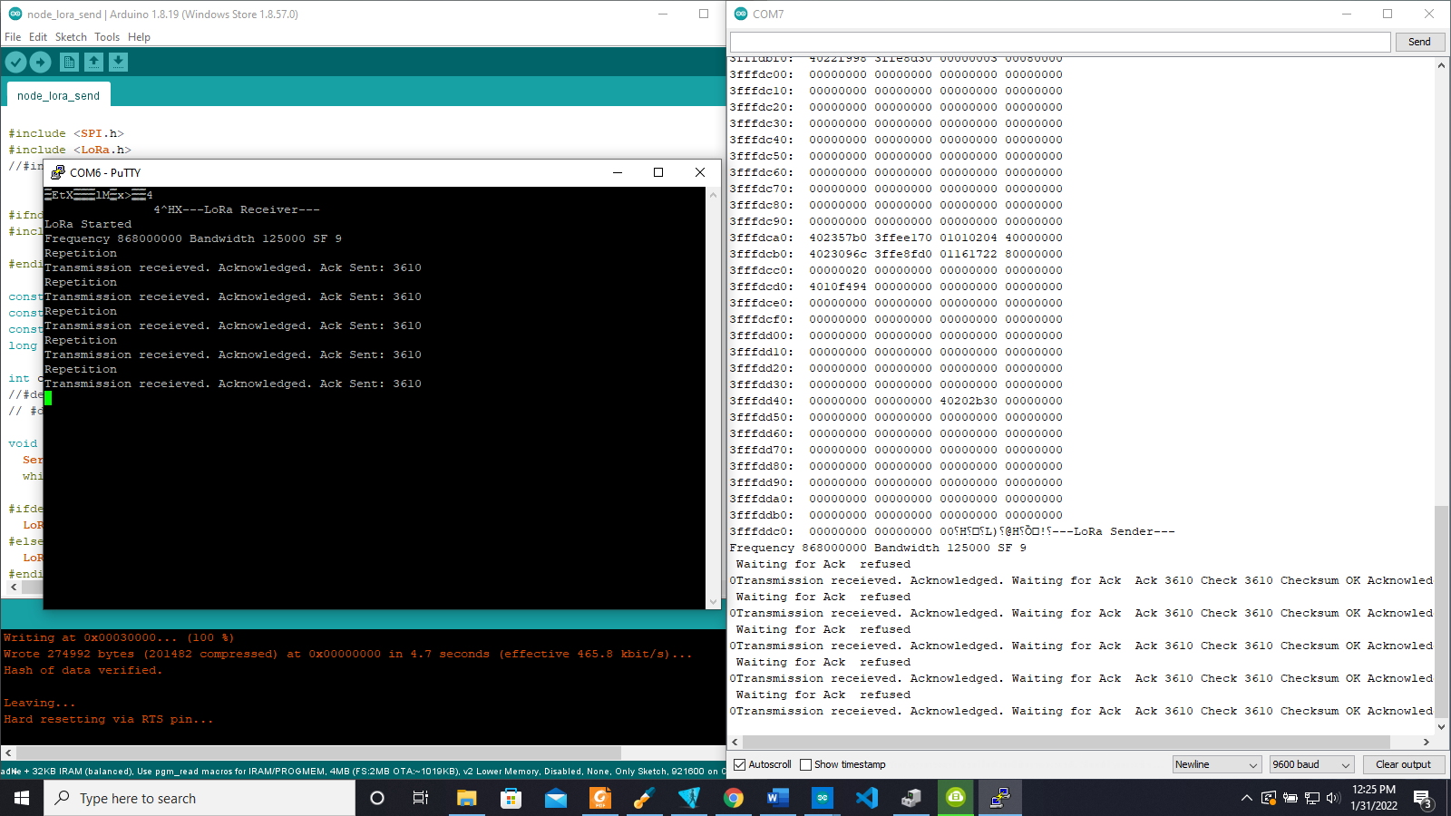
LoRa data transmission and reception test
Receiver
Transmitter

Slide 9
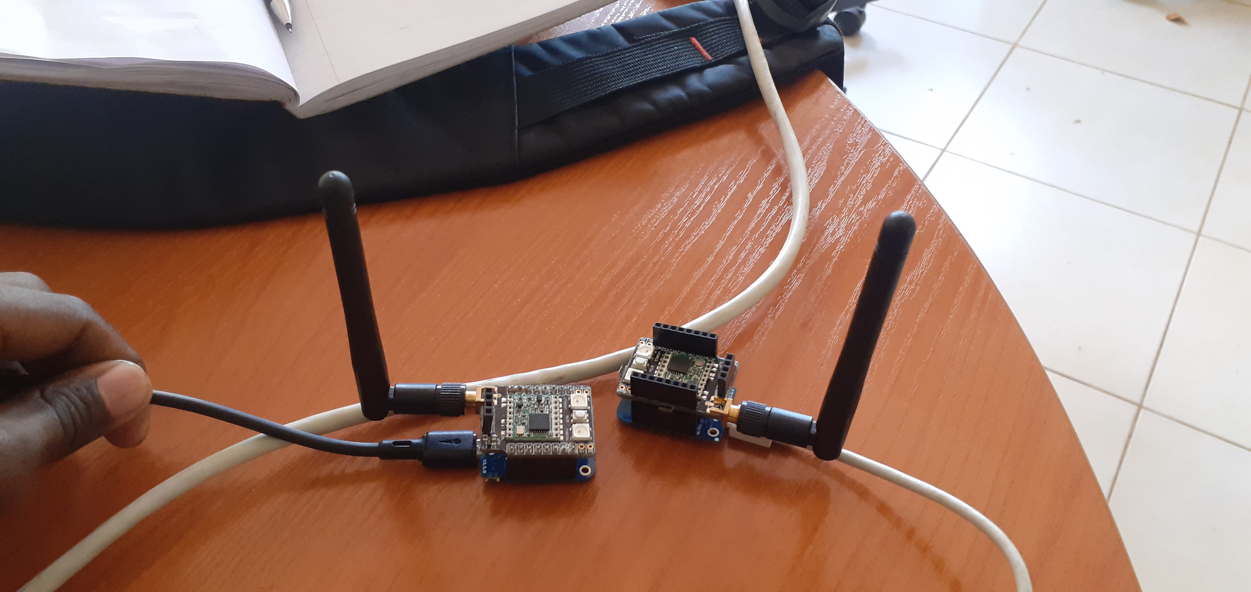
#44 Send and receive image over Lora
Lora can support JPEG compressed image transmission without loss of data packets
The downside is that it cannot support video transmission because of very low bandwidth and transmission speed

Slide 10
#48 Test max distance of Lora
As stated above in regards to distance:
I tested the range to be within the apogee limit of N2 which is 500m
The data recovery was found to be fairly bad in line with our requirements though I did not receive any faulty packets. The message was able to be transmitted as is.
Speed of transmission was very low which rules out the need to use LoRa For transmission

Slide 11
#45 Test speed and bandwidth of Lora
Since there are no given specifications on the Speed and bandwidth of LoRa modules, I wrote code to log the different timestamps at which the message was received at the receiver an compared it with the time the message was dispatched.
Relating this distance and the size of the data packet being sent gives you the speed of transmission with the distance between the transceivers being held constant

Slide 12
Tasks this week
[#23 Avionics bay design]
[#18 Launch pad design]
[#30 Research on camera module]

